Slide 1
How to Copy and Share a Document.
Created by: Melissa Blake for ECHS, Merced CA

Slide 2
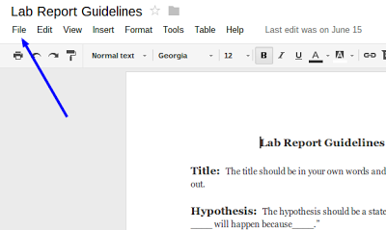
Open the document in Google Docs
Under File, select Make a copy.

Slide 3
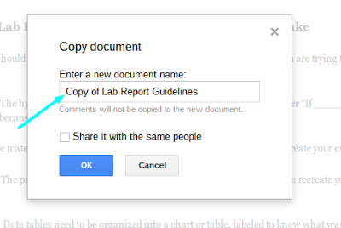
Rename the document by typing in the box

Slide 4
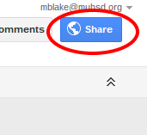
To turn in your document using an electronic form
Click on the share button.

Slide 5
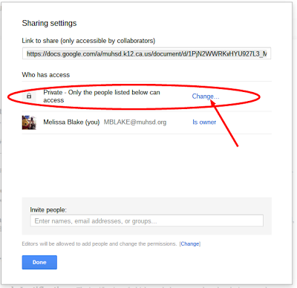
To turn in your document using an electronic form
Click on where it says change.

Slide 6
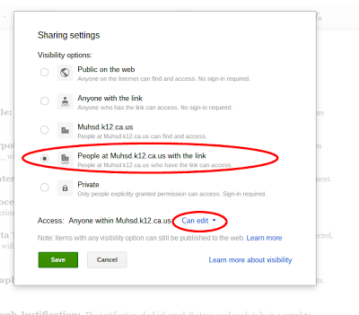
To turn in your document using an electronic form
Make sure that you click people at MUHSD with the link can edit so that it looks like the picture.

Slide 7
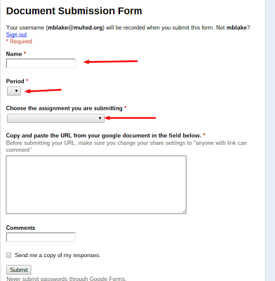
To turn in your document using an electronic form
Open your google form and fill in the blanks.

Slide 8
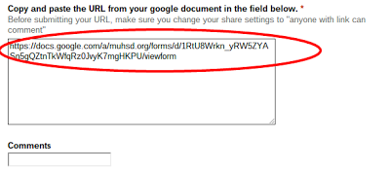
To turn in your document using an electronic form
Copy and paste the URL into your doc here.

Slide 9
To turn in your document using an electronic form
Click Submit and complete your document.

