Slide 1
How to complete a vocab assignment.
Created by Mrs. Blake at ECHS

Slide 2
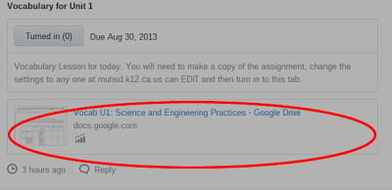
Open document posted

Slide 3
Make a copy under file

Slide 4
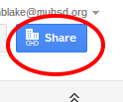
In your copy click on the share button

Slide 5
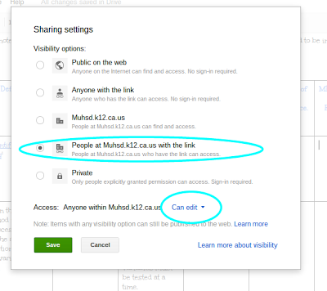
Make sure your screen looks like this

Slide 6
Click save and copy the blue link

Slide 7
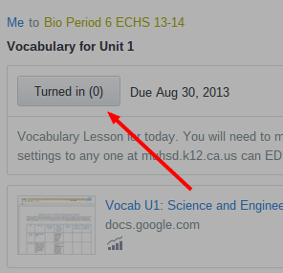
In Edmodo click on turn in assignment

Slide 8
Find the links

Slide 9
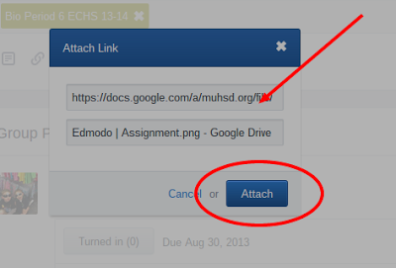
Insert your link and click attach 2 times.

Slide 10
Make sure you Turn it in!
I can always help you tomorrow.

Slide 11
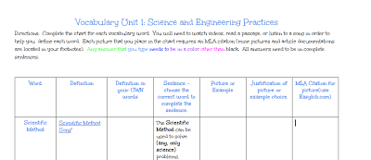
In your document

Slide 12
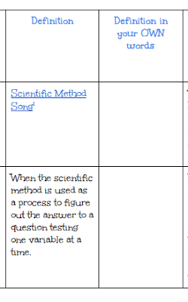
Listen to the video, read the article or what I wrote
This is so you can write your own definition in your OWN WORDS here!

Slide 13
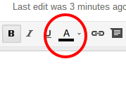
Complete the sentence by highlighting the correct word.

Slide 14
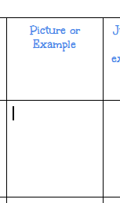
Insert a picture

Slide 15
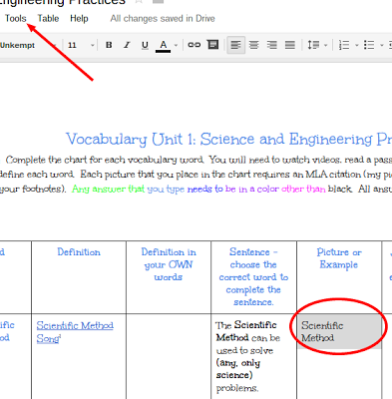
Type the word, highlight it and go to tools

Slide 16
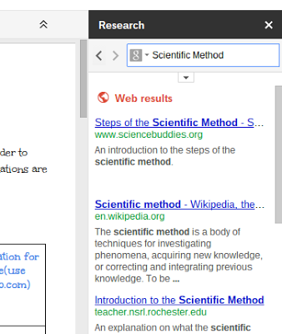
Under tools click research

Slide 17
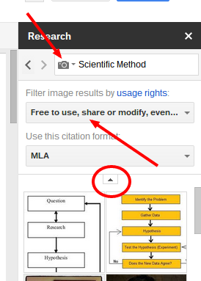
Make these changes
Change the g to images
Make sure the filter says free

Slide 18
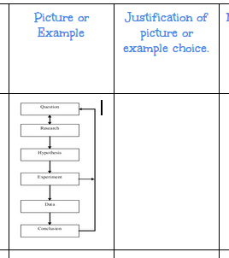
Grab and drop the picture you want into the doc
Explain why you picked that picture.

Slide 19
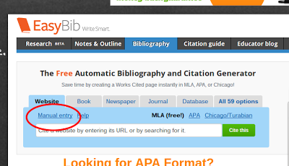
Open a tab called easybib.com click on Manual Entry

Slide 20
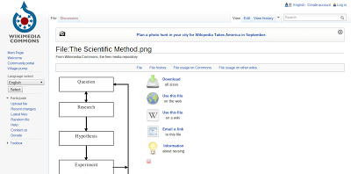
Double click on the image you picked to open its on page.

Slide 21
In easybib change source type to digital image.

Slide 22
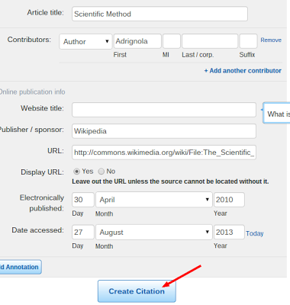
Complete the information and create citation

Slide 23
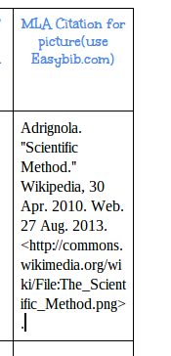
Copy and paste the citation into your document

Slide 24
You are done with 1 word!
There is a quiz on these words Friday when it is due.

